Slide 1
Understanding GAN and VAE
models
25/01/2019

Slide 2
Contents
Introduction
Deep generative models
Experiments
Results
References

Slide 3
Introduction
Both Generative adversarial network(GAN) models and Variational autoencoders(VAE) have been widely used to approximate probability distributions of data sets , to generate the images and learn an approximate distribution from the data samples.
Although they both use parameterized distributions to approximate the underlying data distribution, whose exact inference is intractable, their behaviors are very different.
However for solving such problems in high dimension is intractable, which requires exponentially growing number of samples. As a result, practical algorithms balance the model complexity and sample complexity to trade off model accuracy for efficiency

Slide 4
Deep Generative Models
Generative adversarial network (GAN) and Variational autoencoder (VAE) are two commonly used deep generative models that can generate complicated synthetic images
Some of the variations of GAN and VAE are:
Vanilla GAN
Wasserstein GAN
Vanilla VAE
VAE-GAN

Slide 5
Vanilla GAN
Step 1: Define the problem. Do you want to generate fake images or fake text. Here you should completely define the problem and collect data for it.
Step 2: Define architecture of GAN. Define how your GAN should look like. Should both your generator and discriminator be multi layer perceptrons, or convolutional neural networks? This step will depend on what problem you are trying to solve.
Step 3: Train Discriminator on real data for n epochs. Get the data you want to generate fake on and train the discriminator to correctly predict them as real. Here value n can be any natural number between 1 and infinity.
Step 4: Generate fake inputs for generator and train discriminator on fake data. Get generated data and let the discriminator correctly predict them as fake.

Slide 6
Vanilla GAN
Step 5: Train generator with the output of discriminator. Now when the discriminator is trained, you can get its predictions and use it as an objective for training the generator. Train the generator to fool the discriminator.
Step 6: Repeat step 3 to step 5 for a few epochs.
Step 7: Check if the fake data manually if it seems legit. If it seems appropriate, stop training, else go to step 3. This is a bit of a manual task, as hand evaluating the data is the best way to check the fakeness. When this step is over, you can evaluate whether the GAN is performing well enough.

Slide 7
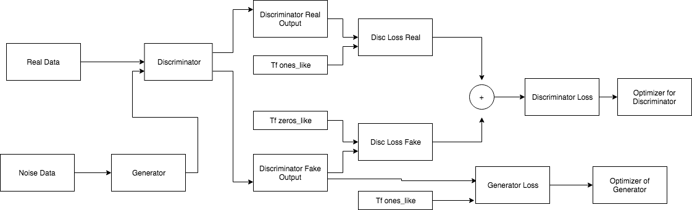
Architecture of GAN

Slide 8
Wasserstein GAN
Wasserstein Distance is a measure of the distance between two probability distributions. It is also called Earth Mover’s distance, short for EM distance, because informally it can be interpreted as the minimum energy cost of moving and transforming a pile of dirt in the shape of one probability distribution to the shape of the other distribution
Example :
Let us first look at a simple case where the probability domain is discrete. For example, suppose we have two distributions P and Q, each has four piles of dirt and both have ten shovelfuls of dirt in total. The numbers of shovelfuls in each dirt pile are assigned as follows:
P1=3,P2=2,P3=1,P4=4
Q1=1,Q2=2,Q3=4,Q4=3

Slide 9
P1=3,P2=2,P3=1,P4=4
Q1=1,Q2=2,Q3=4,Q4=3
In order to change P to look like Q we:
First move 2 shovelfuls from P1 to P2 => (P1,Q1) match up.
Then move 2 shovelfuls from P2 to P3 => (P2,Q2) match up.
Finally move 1 shovelfuls from Q3 to Q4 => (P3,Q3) and (P4,Q4) match up.
If we label the cost to pay to make Pi and Qi match as Δi, we would have Δi+1=Δi+Pi−Qi and in the example:
Δ0 = 0
Δ1 = 0+3-1 = 2
Δ2 = 2+2-2 = 2
Δ3 = 2+1-4 = -1
Δ4 =-1+4-3 = 0
Finally the Earth Mover’s distance is W=∑|Δi|=5

Slide 10
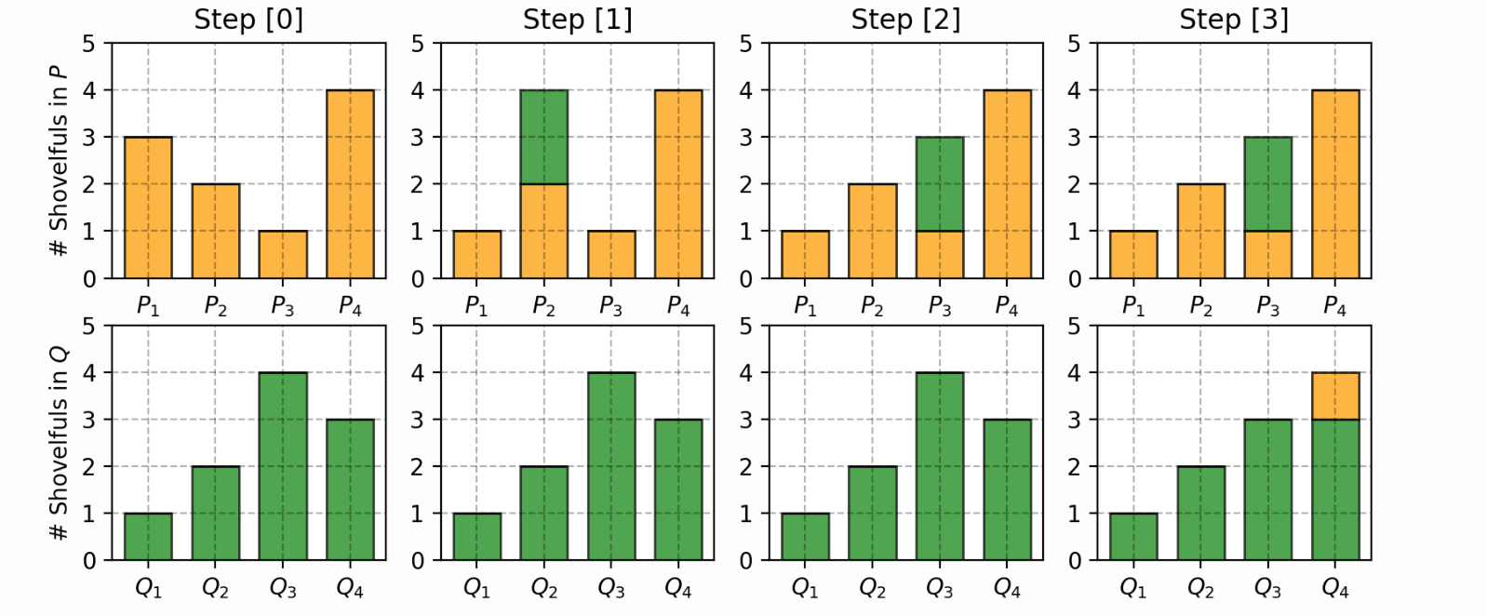

Slide 11
Difference b/w GAN and WGAN
Compared to the original GAN algorithm, the WGAN undertakes the following changes:
No log in the loss. The output of D is no longer a probability, hence we do not apply sigmoid at the output of D
Clip the weight of Discriminator (-0.01 < W < 0.01)
Train Discriminator more than Generator
Use RMSProp Optimizer instead of ADAM Optimizer.
Lower learning rate(α=0.00005)

Slide 12
Variational AutoEncoders
A variational autoencoder (VAE) resembles a classical autoencoder and is a neural network consisting of an encoder, a decoder and a loss function.
They let us design generative models of data and fit them to large data-sets, and can also be used for image generation and reinforcement learning.
For example, a practical application may be to generate trees for a forest in a video game, which are all similar but not the same.
They are a recent advancement in machine learning, having only been defined in 2013. However, they solve a long standing problem in machine-learning and do so with weak assumptions and fast training via back-propagation, which explains their fast rise in popularity.

Slide 13
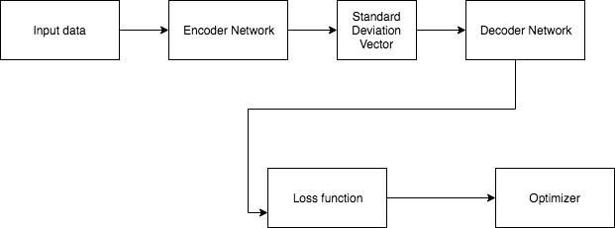
Architecture

Slide 14
VAE-GAN
One advantage of VAE models over GAN models is that it could map an input in the original dataset to latent factors and further to an image in the generator’s approximation.
However, the sample images generated by VAE are usually blurry and of lower quality compared to those from GAN models.
To get the benefits of both, the work proposed an architecture on top of the original VAE models.
The VAE-GAN model adds a discriminator on top of the generated image. The loss function for the discriminator is the same as the one in GAN.

Slide 15
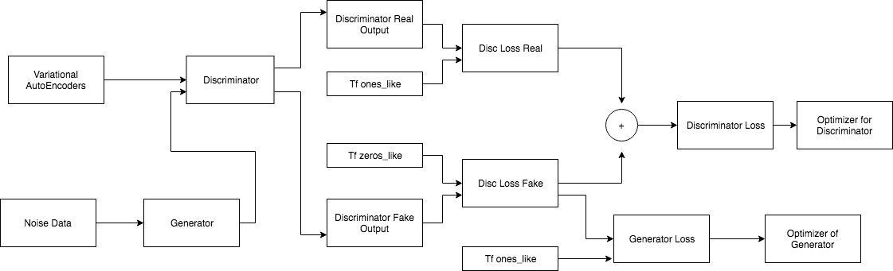
Architecture

Slide 16
Experiments and Results
The original GAN model proposed in produces images of the highest quality. However, since its loss function over-emphasizes its ability to fool the discriminator, the model only produces simple images and suffers from model collapse.
The WGAN model generates images that resemble digits with various shapes and hence solves the mode collapsing problem. However, some samples clearly belong to none of the 10 classes from a human’s perspective.
VAE models , on the other hand, produces pretty images without mode collapsing. However, these images are blurry and can be easily distinguished from samples from the original dataset.
The VAE-GAN model attempts to get the best of both, but ends up producing samples similar to the ones from WGAN. However, it has the same advantage of getting latent vector distribution from an input image as the VAE models do.

Slide 17
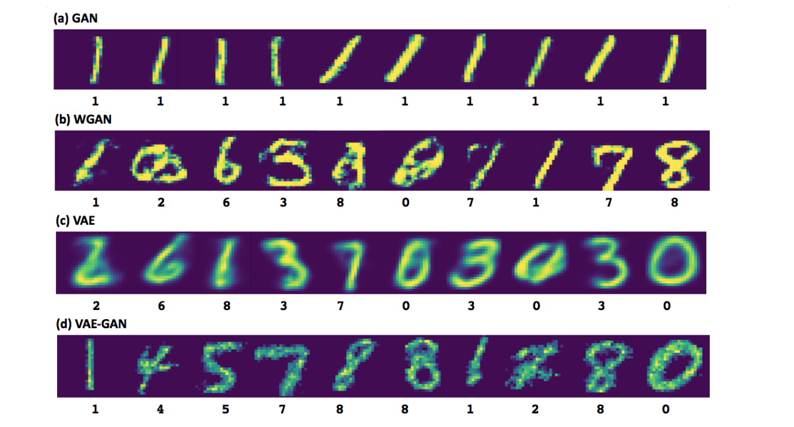
Results

Slide 18
Reference
Understanding GAN and VAE
https://www.analyticsvidhya.com/blog/2017/06/introductory-generative-adversarial-networks-gans/
https://lilianweng.github.io/lil-log/2017/08/20/from-GAN-to-WGAN.html
https://wiseodd.github.io/techblog/2017/02/04/wasserstein-gan/
https://www.doc.ic.ac.uk/~js4416/163/website/autoencoders/variational.html

Slide 19
Thank You

